Slide 1
物理效果仿真
韩红雷
中国传媒大 学动画学院

Slide 2
回顾
刚体
Joint
User Report
它们是PhysX物理引擎的基础
本章将使用它们来创造大范围物理效果
Notes:
From the first two chapters, you have learned all about rigid bodies and joints; the fundamentals of the SDK. You will now use what you have learned to create large scale physics effects.

Slide 3
Aggregates
An aggregate is a collection of actors
do not provide extra simulation or query features
allow you to tell the SDK that a set of actors will be clustered together
allows the SDK to optimize its spatial data operations
Ragdoll
It is typically more efficient to represent the rag doll in the broad phase as a single entity, and do internal collisions in a second pass if necessary.

Slide 4
Creating an Aggregate
PxPhysics* physics; // The physics SDK object PxU32 nbActors; // Max number of actors expected in the aggregate bool selfCollisions = true; PxAggregate* aggregate = physics->createAggregate(nbActors, selfCollisions);

Slide 5
Populating an Aggregate
Adds an actor to an aggregate as follows:
PxActor& actor;
aggregate->addActor(actor);
To add the aggregate to a scene (before or after populating it):
scene->addAggregate(*aggregate);
Similarly, to remove the aggregate from the scene:
scene->removeAggregate(*aggregate);

Slide 6
Releasing an Aggregate
To release an aggregate:
PxAggregate* aggregate;
aggregate->release();

Slide 7
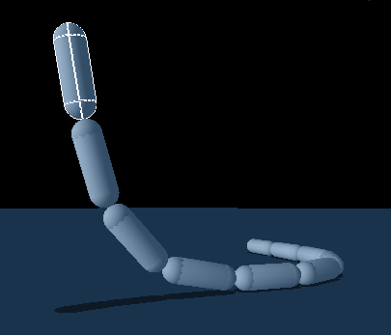
Rope

Slide 8
原理
通过将多个刚体使用球形joint连接来构造绳索
可以用这种方式来构造绳索、链条和消防软管
Notes:
In this lesson, we will create a rope out of rigid bodies connected together by spherical joints. The rope we create is an interactive effect and can be used to make rope, chains, firehoses, etc.

Slide 9
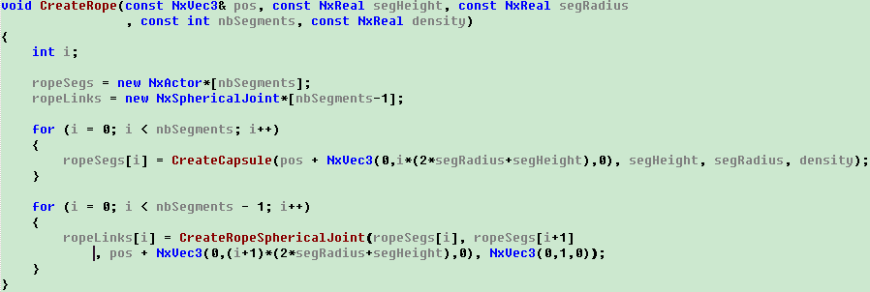
如何构造绳索

Slide 10
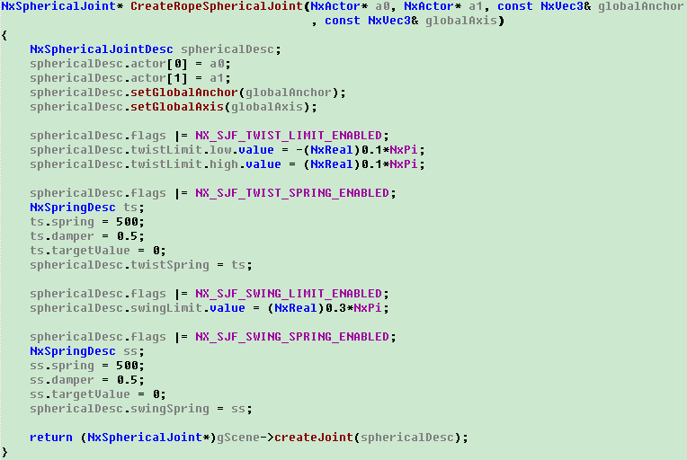
构造绳索各部分间的Joint

Slide 11
思考并练习（15分钟）
如何具体实现
如何构造更加柔软的绳子

Slide 12
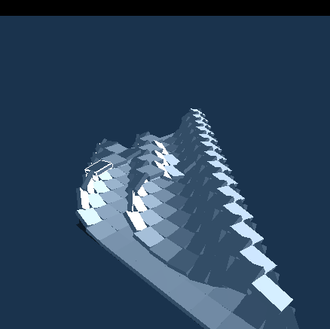
Jointed Rigid Body Cloth

Slide 13
说明
本例中使用了16×16个box型的actor，然后将他们用球形joint连接起来
类似于床垫的形状
可以用来模拟斗篷等
Notes:
16-by-16 grid of box shape actors and joining them together with spherical joints

Slide 14
思考并练习（20分钟）
如何具体实现
这种模拟效果有哪些问题

Slide 15
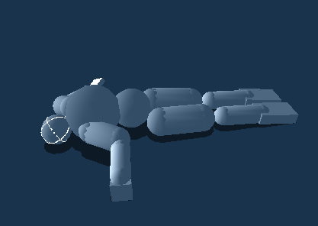
Ragdolls

Slide 16
说明
经常用来在游戏中表现角色受伤或者死亡等状态
游戏中的策略：
使用骨骼和适当的质量定义角色
一般情况下关闭物理仿真，让角色来播放事先编辑好的动画
在必要的时候关闭动画控制，让角色在Ragdoll物理仿真下运行
Notes:
Ragdolls are often used in games to simulate a character going limp or staggering back after getting injured. Build your character with the joints and masses in place from the beginning. Then turn off the physics on the character and make it move under your animation. When you want the character to go ragdoll, turn off the animation control, make the bodies in the ragdoll dynamic, and turn on their joints.

Slide 17
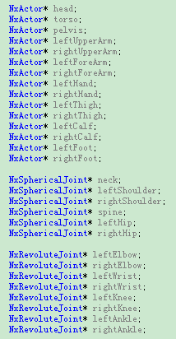

Slide 18
思考并练习（20分钟）
如何具体实现
如何将实现不同的骨骼

Slide 19
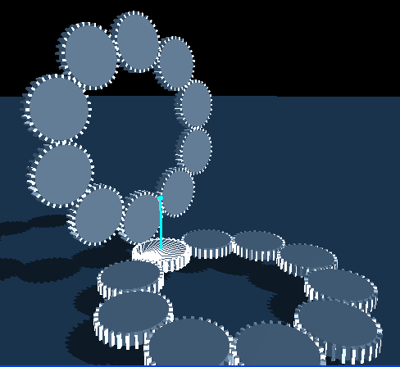
Gears

Slide 20
如何构造
齿轮的中心部分是一个convex shape，齿部分是box shape
一个齿轮是由一个中心部分和多个齿构成的多shape的actor
齿轮通过一个revolute 型的joint和世界相连
Notes:
In this lesson, we create a gear using a convex shape for its center and box shapes for teeth. We then make copies of the gears and joint them to the world with revolute joints to create an array of interlocking gears that move together.

Slide 21
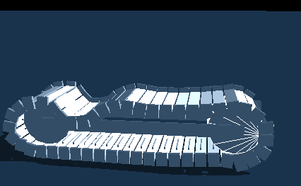
Gears and Belt
对于上一小节进行了修改
在InitNx函数中，构造两个轮子，使用圆柱并且使用box来模拟齿轮
使用多个门扇性joint组成的履带来连接两个轮子
齿轮正好卡住履带
Notes:
In this lesson, we take a modified version of the gear from the last lesson and wrap a belt around it to create a functioning tread.
In InitNx(), we created two wheels, each made of three round triangle meshes and several box shapes for teeth. We connected the two wheels to a frame by revolute joints.
We then built a belt made of "steps" linked together with revolute joints. The tread was constructed so that the teeth of the two wheels interlocked with the teeth of the steps in the tread; thus, the wheels move the tread along as they rotate.

Slide 22
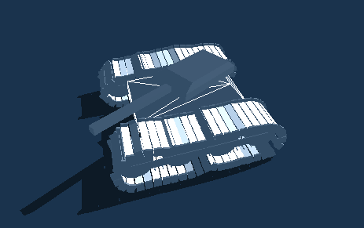
Tank

Slide 23
原理
是前面几节的合成
构造了两个类： class Tread 和class Tank
前者是上一节的修改
后者由两个履带、底盘、炮塔和炮筒组成
底盘用两个fixed joint连接履带
炮塔和底盘由门扇型joint连接
炮筒和炮塔由门扇型joint连接
Notes:
First, creat a Tread class and a Tank class from which to construct the tank: class Tread { NxActor* wheel[4]; NxActor* frame; NxActor* step[47]; NxRevoluteJoint* wheelJoint[4]; NxRevoluteJoint* stepJoint[47]; }; class Tank { ... Tread* tread[2]; NxActor* chassis; NxActor* turret; NxActor* cannon; NxRevoluteJoint* chassisJoint [2]; NxRevoluteJoint* turretJoint; NxRevoluteJoint* cannonJoint; }; The tread is essentially the same as in the last lesson, only now it has four wheels. The tank is created from two treads, a chassis, a turret, and a cannon. The chassis is connected to the tread by two fixed joints, the turret is connected to the chassis by a revolute joint, and the cannon is connected to the turret by another revolute joint.

Slide 24
Tank发动机
使用NxMotorDesc类型来构造
每个履带有一个发动机
通过按键可以为履带设置不同的发动机

Slide 25
思考并练习（20分钟）
如何具体实现
如何构造更加复杂的汽车模型

Slide 26
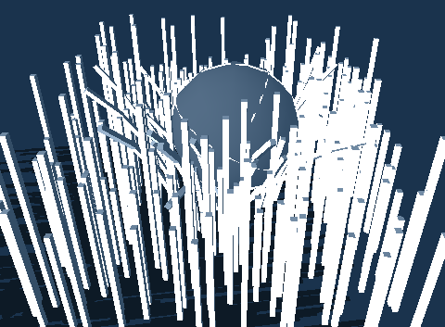
Grass

Slide 27
原理
和构造绳子类似
草丛是通过使用球型joint将刚体连接
对球型joint施加一些约束以及阻尼
Notes:
This is a lesson on how to create grass. Much like rope, a blade of grass is a line of rigid bodies linked together by spherical joints. Making the joint with a limit and a spring helps define an object that tries to restore its original position.

Slide 28
思考并练习（30分钟）
如何具体实现
如何将颜色进行修改，以便模拟更加真实的草丛
如何结合渲染来构造更加真实的场景
渲染采用模型的方式
其位置属性由physx决定

Slide 29
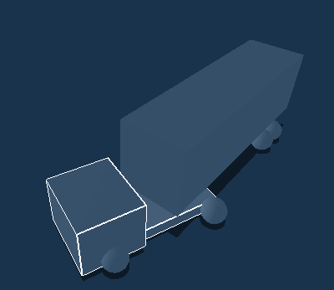
Articulated Truck

Slide 30
原理
本课要构造铰链式的卡车
由车头和车厢组成
车头和车厢通过门扇型joint连接
每个轮子用门扇型joint连接到没有形状的翻滚轴上
翻滚轴通过棱形joint和车身连接，并且使用了弹性模拟悬挂
Notes:
In this lesson, we build a fully articulated tractor-trailer truck. The truck is comprised of a tractor actor and a trailer actor. The tractor actor is hitched to the trailer actor by a revolute joint. Each wheel is connected by a revolute joint to a shapeless roll-axis actor. The roll-axis actor is connected to the tractor (or trailer) by a prismatic joint and the roll-axis actor is held to the tractor (or trailer) by a tight spring, which simulates the vehicle's suspension. The two front steering wheels are differentiated from the regular wheels in that they are connected to their roll-axis actor by an additional steer-axis actor via a revolute "steering joint", whose global axis is set along the y-axis.

Slide 31
思考并练习（20分钟）
如何具体实现
卡车的动力系统

Slide 32
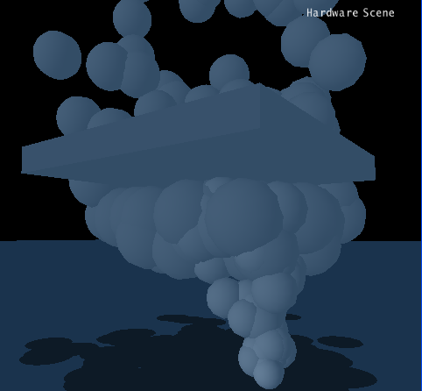
粒子系统

Slide 33
原理
学习如何构造粒子系统发射器
每帧生成新的粒子
每帧更新粒子的状态
生成的粒子被归类到同一个组中，而这个组内的成员没有碰撞
Notes:
In this lesson, we will create a particle emitter class and a particle class. The particle emitter object spawns new particle objects on every frame. The particles are actors that get updated on their own every frame.

Slide 34
思考并练习（重点）30分钟
如何具体实现
结合以前的粒子系统知识
构造爆炸、瀑布等其他粒子系统效果

Slide 35
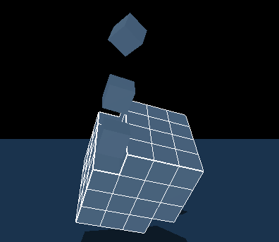
Fragmenting Objects

Slide 36
应用
很多游戏中有物品的破碎效果
本课学习如何构造由碎片组成的actor
这个actor可以破碎成多个独立的actor
Notes:
In many games, you want to create destructible objects that break apart or explode into component and/or prefractured pieces. In this lesson we show how to construct an actor from pieces, the actor's shapes conforming to the pieces, then disengage the shapes from the main actor and building them into their own autonomous actors.

Slide 37
思考并练习（30分钟）
如何具体实现
如何构造更加复杂的可破碎actor
由不同类型shape构成
比如布娃娃系统

